Slide 1


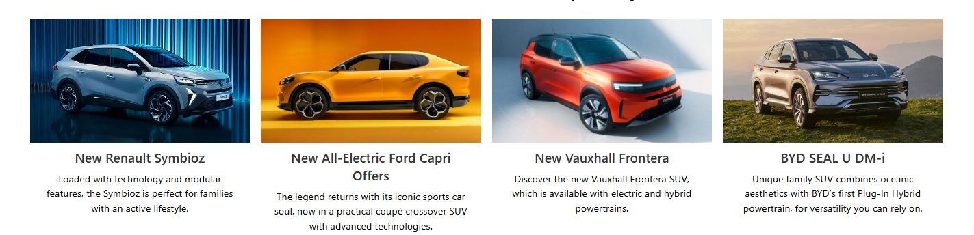
/
/
About Us
Home
Buy Cars
Peak Performance Autos
Drive Your Dreams Home Today!
Featured

Slide 2

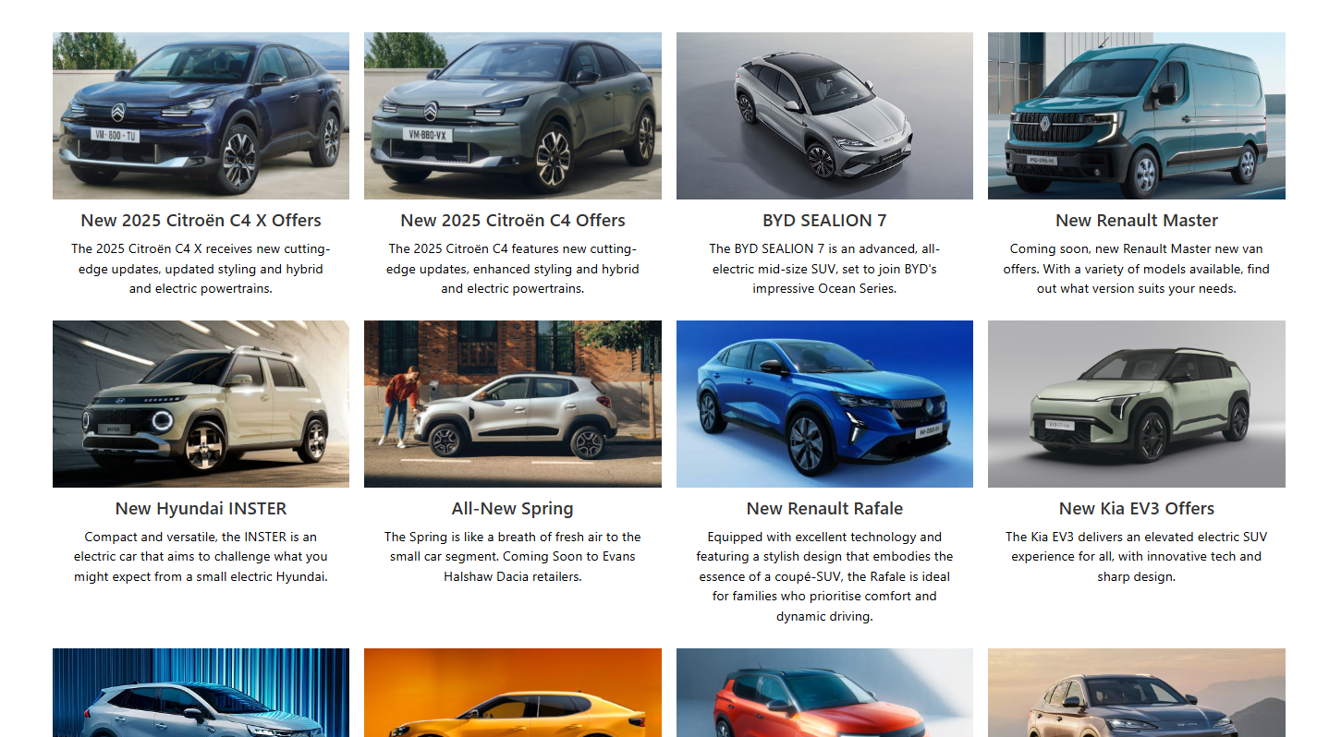
/
/
About Us
Home
Buy Cars
Peak Performance Autos
Search…

Slide 3
About Us
/
/
About Us
Peak Performance Autos
Home
Buy Cars
Home Inventory About Us
Peak Performance Autos
Welcome to Peak Performance Autos! We are a trusted car dealership dedicated to providing high-quality vehicles and exceptional customer service. Whether you're looking for a reliable used car, a sporty new model, or something in between, we have a wide selection to meet your needs.
At Peak Performance Autos, we believe in making the car-buying experience simple, transparent, and enjoyable. Our friendly team is here to help you find the perfect vehicle that fits your lifestyle and budget.
Visit us today and discover why so many customers choose Peak Performance Autos for all their automotive needs!

Slide 4
HEX: #FF0000
HEX: ##FFFFFF
Colour Themes
Logo
Peak Performance Autos
Dealership Name

